Slide 1
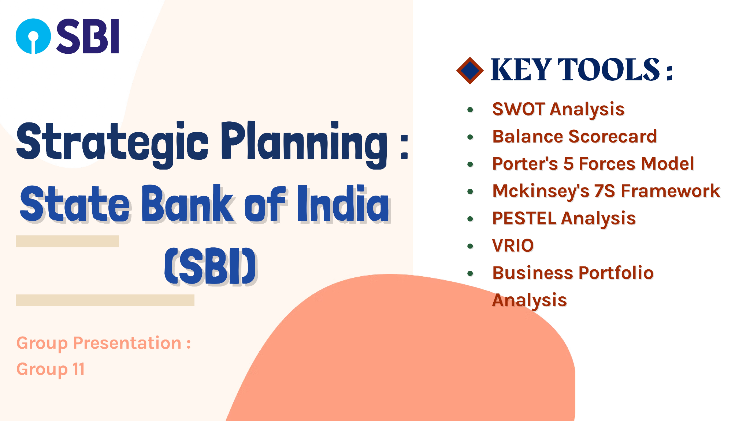

Slide 2
Team Members
1. Sandeep Kumar(Leader) 24b0315
2. Rakshana Sundaram(Co Leader) 24b2428
3. Preisha Premal Desai 24b2472
4. Syed Mohammad Ali 24b1273
5. P H Mohit 24b1235
6. Sai Pranay Kumar Singh 24b1276
7. Jagtap Suyash Laxman 24b1251
8. Sumukh M G 24b1087
9. Arth Shivhare 24b2404
10. Haripreeth Senthil Kumar Pichandi 24b0920

Slide 3
SWOT Analysis of SBI

Slide 4
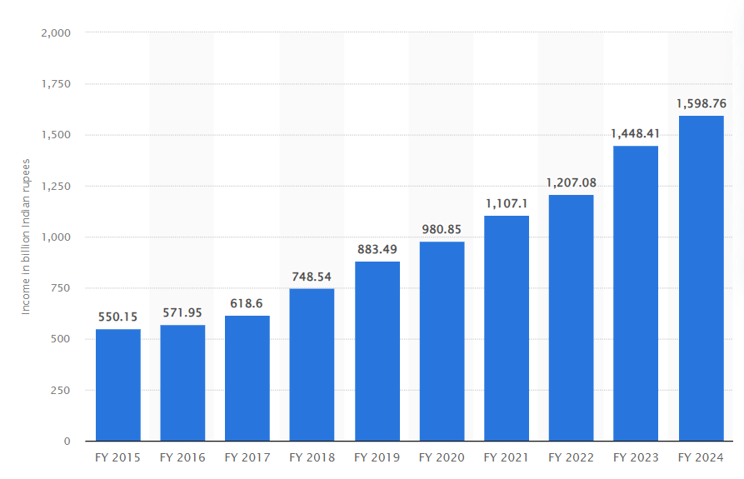
Strengths:-
Market Leadership and extensive branch network.
Diversified Product portfolio.
SBI offers a wide range of financial products, including retail and corporate banking, insurance, investment banking, mutual funds, and more. This diversification helps in managing risk and catering to different customer segments.
Net interest income

Slide 5
Weakness:-
Large number of employees.
SBI employs around 2.46 lakh individuals globally, with a vast branch network and outreach, even in international markets​. In contrast, HDFC Bank employs about 1.21 lakh people, indicating that private banks operate with relatively fewer employees, emphasizing higher productivity per employee​.
High NPAs (Non-Performing Assets):
SBI has historically faced challenges with high levels of NPAs. This affects profitability and requires higher provisioning.
SBI’s Gross NPAs dropped to 2.78% as of March 2023, a significant improvement from 10.91% in 2018.
Some popular NPAs of SBI
MTNL (Declared NPA on Oct 5,2024)
Kingfisher airlines
Jet airways

Slide 6
Opportunity:-
Expansion in Wealth Management and Insurance sector.
With rising incomes and financial literacy in India, there is growing demand for wealth management and insurance products. SBI's subsidiaries, such as SBI Life Insurance and SBI Mutual Fund, can capitalize on this trend.
As of recent reports, SBI holds a considerable portion of the wealth management market in India. The bank has approximately 10-12% of the overall market share in wealth management. This positioning stems from its extensive branch network, trusted brand, and comprehensive service offerings.
And In the insurance market it is one of top players in life insurance, SBI life insurance holds up to 20% of private life insurance market share, making it a top player in the sector. While in general insurances SBI General holds a decent share of 8-10%.

Slide 7
Opportunity:-
Digital Banking Expansion
The increasing adoption of digital banking services offers an opportunity for SBI to enhance customer engagement, improve operational efficiency, and reach younger, tech-savvy customers. However, the bank faces stiff competition from private players like HDFC Bank and ICICI Bank, which have more streamlined digital experiences. There’s still a need for continuous innovation to stay ahead of the curve.

Slide 8
Threats:-
Private Sector Competition.
The State Bank of India (SBI) faces intense competition from private banks like HDFC Bank, which holds a market share of around 10.2% in deposits and 9.7% in advances, compared to SBI's 24% and 22%, respectively. Private banks excel in digital banking, with ICICI Bank reporting over 90% of transactions conducted digitally, while SBI stands at around 70%. Additionally, private banks are expanding into semi-urban and rural areas, leveraging digital platforms to attract customers in markets traditionally dominated by SBI. Fintechs and digital-only banks also pose a threat.
Regulatory Pressure.
Being a public sector bank, SBI is under constant regulatory scrutiny. Changes in government policies, including interest rate controls and tighter regulations, can limit the bank’s operational flexibility.

Slide 9
BALANCE SCORECARD
The balance scorecard concept of strategic planning includes 4 main aspects:
Financial aspect
Customer focus
Internal business processes
Learning and growth

Slide 10
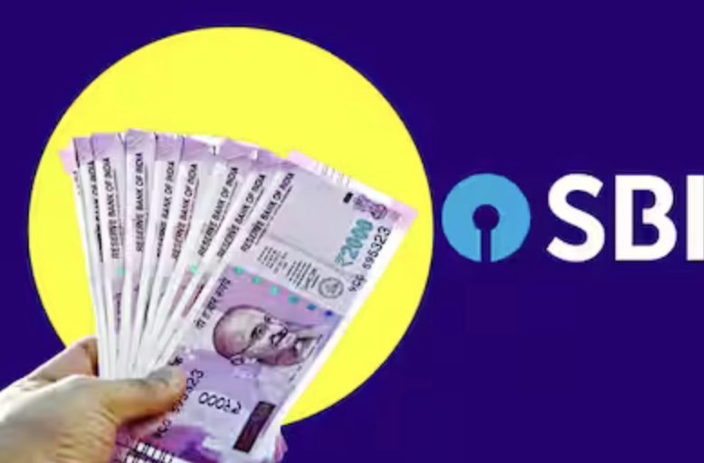
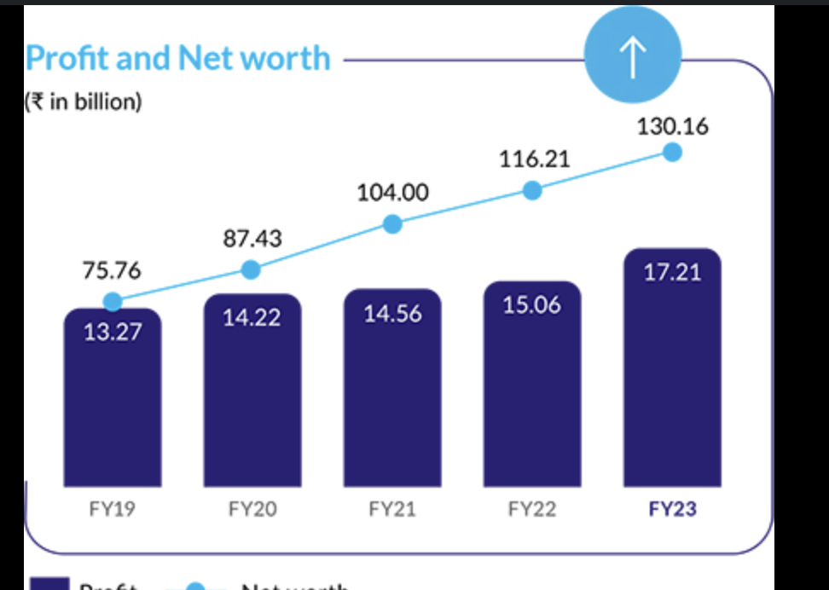
FINANCIAL ASPECT
Profitability : SBI has generated a net profit of 61076 crores approximately over the last financial year .
ROCE: SBI has a ROCE of approximately 1.50 which is a little on the lower side as compared to other banks that it competes with.
Cash flow: Over the last year SBI has converted its negative to positive cash flow of 2902.37 crores approximately.
Sales Growth : SBI expects a credit growth of almost 15% for FY 2025 across all segments.

Slide 11

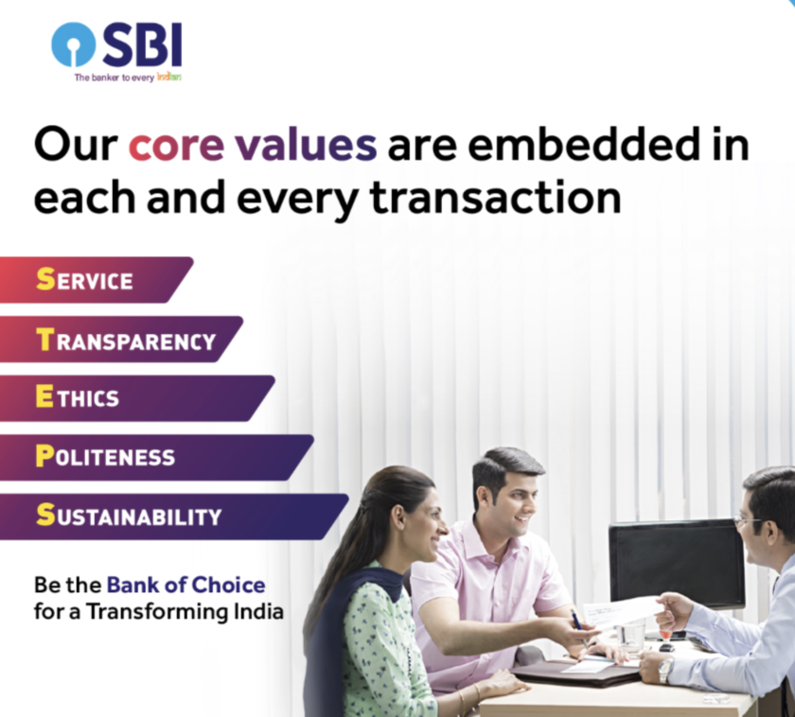
INTERNAL BUSINESS PROCESSES
Operations: It has spread its presence globally and operates across time zones through 241 offices in 29 foreign countries.
Quality: SBI focuses on various aspects like ethical culture,better asset quality,smoother promotion and transfer process , a well established career development system.
Innovations:Various schemes launched like PM Surya Ghar, increase in Priority Sector Lending to agricultural sector.
Warranty:Being one of the oldest banks in Inida, it has made its marks in reliability.
Processes:It publishes annual Transparency audit reports in order to validate its processes.

Slide 12
CUSTOMER FOCUS
1.Omnichannel Access: SBI has strengthened its presence across digital and physical channels, enhancing accessibility for all customers, including those in rural and semi-urban areas.
2.Enhanced Customer Experience through Personalization: SBI leverages data analytics to provide personalized services tailored to individual customer needs.
3.Support for MSMEs: SBI has introduced special schemes, such as the SME Smart Score and tailored loan products, to support Micro, Small, and Medium Enterprises (MSMEs).
4YONO:SBI has continued to expand its digital services, especially through the YONO (You Only Need One) platform, which provides one-stop digital banking experience for customers. This includes features like instant personal loans, pre-approved loans for small businesses, and investment options.

Slide 13
LEARNING AND GROWTH
1.Talent Development and Retention: SBI places high importance on talent retention and growth by fostering a positive work environment with awards for excellence in HR practices.
2. Continuous Learning Initiatives: SBI offers ongoing training and development programs focusing on digital skills, risk management, and customer service
3.Leadership Development Programs: To sustain a strong leadership pipeline, SBI has implemented succession planning at senior levels and leadership training for emerging managers.
4.Feedback from Employees: Regular feedback through Engagement and Happiness Surveys ensures continuous improvement in employee satisfaction.

Slide 14
BUSINESS PORTFOLIO ANALYSIS
PURPOSE—To assess SBI’s diverse business units and identify strengths, weakness and growth potential.
KEY BUSINESS SEGMENTS—
1.RETAIL BANKING:Core services like personal accounts and loans
2.CORPORATE BANKING:Service like large clients and trade finance
3.INSURANCE AND WEALTH MANAGEMENT: Growing demands like SBI’s Life Insurance and SBI’s mutual funds
4.INTERNATIONAL BANKING:Operations in 30+ countries

Slide 15
FINANCIAL PERFORMANCE—
REVENUE CONTRIBUTION:Significant from retail and corporate banking
PROFITABILITY:Higher margins in insurance and wealth management
GROWTH TRENDS:Strongest in digital services

Slide 16
STRATEGIC INITIATIVES—
DIGITAL BANKING INVESTMENTS:Focus on platform like SBI YONO
RURAL PENETRATION:Growth in un-deserved areas
SUSTAINABILITY:Green banking initiatives and CSR
FUTURE OUTLOOK—
GROWTH FOCUS:Digital,insurance, and wealth management
OPTIMIZE PORTFOLIO:Streamline low-performing international units
INNOVATION:Collaborate with fintech for new services and customer engagement

Slide 17
PORTERS’ 5 FORCES MODEL
In context of SBI, the 5 forces model can help us analyse the competitive environment and market dynamics.

Slide 18
THREAT TO NEW ENTRANTS :
Entry Barrier :The banking sector has high barriers to entry. The newcomers face significant challenges in gaining market trust & share.
Customer Loyalty : SBI has a strong brand reputation and customer loyalty which clearly makes it difficult for other banks to attract customers.
Overall Threat Level : LOW TO MODERATE

Slide 19
2. BARGAINING POWER OF SUPPLIERS :
Funding Sources: In banking, suppliers include depositors and investors. SBI, being a large institution, has various funding sources, which decreases individual supply power.
Regulatory Framework: Regulations from the Reserve Bank of India (RBI) also affect the dynamics, as compliance costs can impact profitability.
Overall Threat Level: LOW

Slide 20
3. BARGAINING POWER OF BUYERS :
Customer Options: With many banks offering similar products, customers have options, increasing their bargaining power.
Switching Costs: While switching costs are relatively low, SBI’s extensive branch network and service offerings create some loyalty among customers.
Overall Threat Level: MODERATE

Slide 21
4. THREAT OF SUBSTITUTE PRODUCTS :
Alternate Financial Services :
The rise of fintech companies, and non-banking financial companies (NBFCs) poses a threat as they offer alternative financial solutions.
Overall Threat Level : MODERATE TO HIGH

Slide 22
5. INDUSTRY RIVALRY :
Competition: SBI faces intense competition from both public and private sector banks, as well as from emerging fintech firms.
Market Share: SBI holds a significant market share, but competition for loans, deposits, and other financial services remains fierce.
Overall Threat Level: HIGH

Slide 23
PESTEL ANALYSIS
Political Factors:
Government Regulations: The banking sector in India is heavily regulated by the RBI. Changes in monetary policies,tax policies, interest rates, and banking regulations can directly impact SBI.
Public Sector Bank: SBI often aligns with government initiatives, such as the Pradhan Mantri Jan Dhan Yojana (PMJDY), which aims at providing financial services to unbanked populations. This scheme led SBI to open millions of zero-balance accounts.
Political Stability: A stable political environment is crucial for banking stability. Political tensions or unrest can impact financial markets and the operations of the bank.
Economic Factors:
Interest Rates: Fluctuations in interest rates can affect loan demand and profit margins. A lower interest rate environment may increase loan demand but compress net interest margins; Influences customer spending.
Economic Growth: The overall health of the Indian economy, including GDP growth, inflation rates, and unemployment levels, influences loan growth and non-performing assets (NPAs).
Exchange Rates: For international transactions and foreign loans, exchange rate volatility can impact SBI's international operations and forex reserves.

Slide 24
PESTEL ANALYSIS
Social Factors:
Changing Customers Preferences: With the rise of digital banking, more customers are moving away from traditional banking methods. For instance, SBI's YONO (You Only Need One) app
Financial Inclusion: SBI has a major role in promoting financial inclusion in rural and semi-urban areas as part of government and RBI initiatives. Eg. PMJDY
Cultural Factors: Savings and gold investments are culturally significant in India. SBI has launched specific products like gold loans and recurring deposit schemes that cater to these cultural preferences.
Technological Factors:
Digital Transformation: The competition from fintech firms like Paytm and PhonePe has pressured SBI to enhance its digital offerings. The YONO app is a response to this trend to remain competitive.
Cyber Security: With increased digital transactions, cybersecurity threats are a major concern. SBI needs to invest in advanced security measures.
Mobile Banking and AI: With a significant portion of the Indian population using smartphones, mobile banking and app-based solutions are crucial for reaching a wider audience; AI and Automation is being used to make this process more efficient. Eg. “SBI Intelligent Assistant” (SIA).

Slide 25
PESTEL ANALYSIS
Environmental Factors:
Sustainability: SBI has committed to green banking practices, such as financing renewable energy projects. In 2021, it announced plans to finance solar energy projects worth billions to support India’s renewable energy goals.
Climate Change: Natural disasters and climate change can affect banking operations, loan recovery, and credit risk, especially in agrarian and flood-prone areas. Eg. Floods and cyclones in Kerala, Odisha etc.
Regulatory Push: The RBI has encouraged banks to invest in green initiatives. In response, SBI issued the country's first green bonds in 2018, raising $650 million to finance eco-friendly projects.
Legal Factors:
Banking Laws: Compliance with banking and financial regulations is essential. The Banking Regulation Act, RBI guidelines, and anti-money laundering laws need strict adherence; KYC norms require SBI to update and verify customer details.
Consumer Protection Laws: Ensuring the protection of consumer data and fair banking practices is important for maintaining consumer trust.
Labour Laws: Being a large employer, SBI needs to comply with employment laws, union regulations, and employee benefits policies.
Litigation Risks: The bank faces potential legal challenges, including those related to loan defaults, mergers, or customer grievances.

Slide 26
McKinsey's 7S Framework
Two main objectives of SBI in the recent years that we are going to discuss:
1. To become a major player in corporate and institutional lending.
2.To dominate the Digital Banking sector .

Slide 27
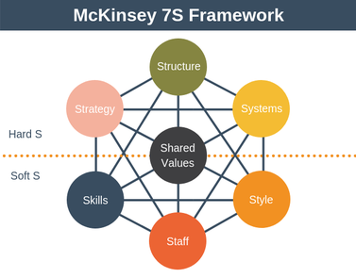

Slide 28
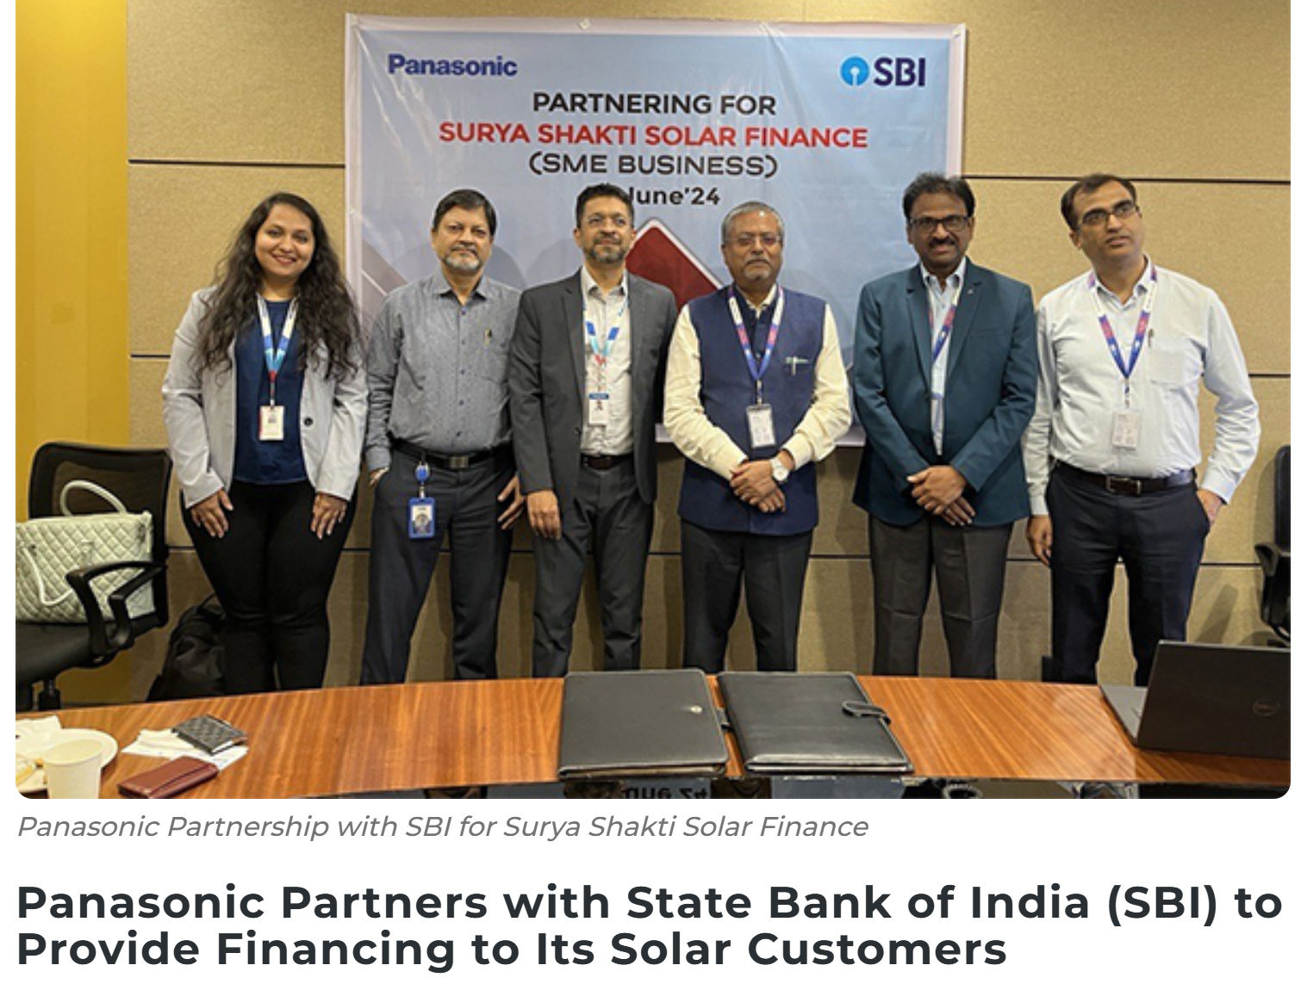
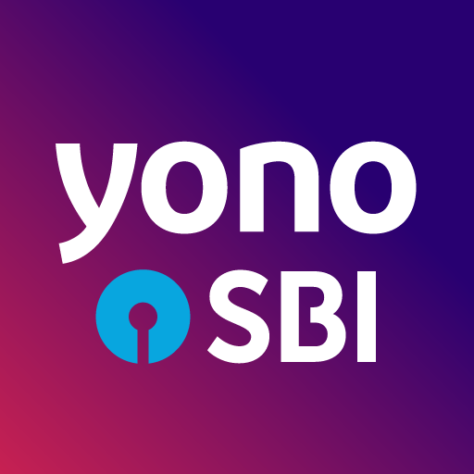
Strategy
Digital Banking
Launch of YONO.
Introducing SIA (SBI Intelligence Assistant).
Institutional Lending
Partnership and Alliances
Aggressive Marketing and Outreach

Slide 29
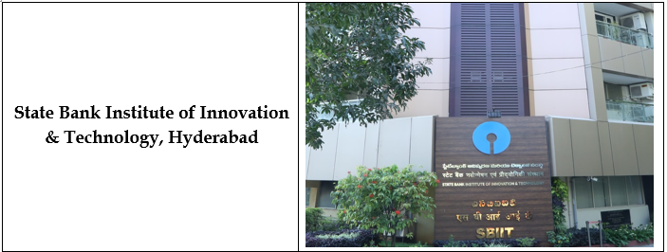
Structure:
For digital expansion
Appointing CDO (Chief Digital Officer).
Establishment of Digital Banking and Transformational Department.
For Institutional lending
Creating assessment teams
Establishing a framework for evaluating
Project viability
Financial risks
Potential returns

Slide 30
System:
For digital expansion:
Revamping IT infra and cloud adoption
Creating dedicated cybersecurity development teams.
For Institutional lending
Adopting Automation and AI
Adopting Data analytics for less bias

Slide 31
Shared Values:
The digital expansion emphasizes SBI’s vision to become “THE BANKER TO EVERY INDIAN”.
In order to become a global leader , it has to strengthen its corporate lending and institutional lending.

Slide 32
Style:
Customer Centric Approach.
Strategic and Transformational Management.

Slide 33
Skill:
In accordance to its digital expansion , SBI has started training its employees in :
Using banking platforms , mobile apps & other tech tools
Data analytics
To gain expertise over AI and ML.
To improve its lending , SBI has developed courses such as:
Financial Modelling
Due diligence
Advanced project evaluation technique

Slide 34

Staff:
To strengthen its technological capabilities, SBI has started recruiting specialists in :
Cybersecurity.
AI.
Blockchain.
Digital product development.
SBI is increasingly using lateral recruitment to bring in professionals with experience in:
Corporate banking.
Project finance.
Risk management.

Slide 35
VRIO (Value,Rarity,Imitability and Organization)
>>VRIO framework is a strategic analysis tool that examines a company’s resources and capabilities to identify potential competitive advantages.
VALUE:SBI has significant value in its vast network,customer base and brand recognition,especially in india.
RARITY:The scale and reach of SBI,as a public sector bank with government backing,are rare in india.
IMITABILITY:While SBI’s digital services and some aspects of its banking products could be imitated,the sheer scale of its infrastructure,customer loyalty and government support are hard to replicate.
ORGANIZATION:SBI is well-organized to capture value from its resources,with a structured approach to risk management,digital initiatives, and talent acquisition.

Slide 36
